Slide 1
Camila Sleep App
Performance Review
TEAM 4 - Haruko Okada, Sergio Martelo, Mingi Lee, Dylan Laurianti
April 22th, 2024
Notes:
10

Slide 2
Progress Estimation per Epic
100%
Client Onboarding
Backend API / Database
Mobile UI
Web UI
90%
90%
65%
Notes:
Sergio 110

Slide 3
Progress Estimation per Epic cont.
100%
Event Tracking
Chat
Docs / Style
DX
Deployment
60%
90%
100%
75%
Notes:
Sergio 100

Slide 4
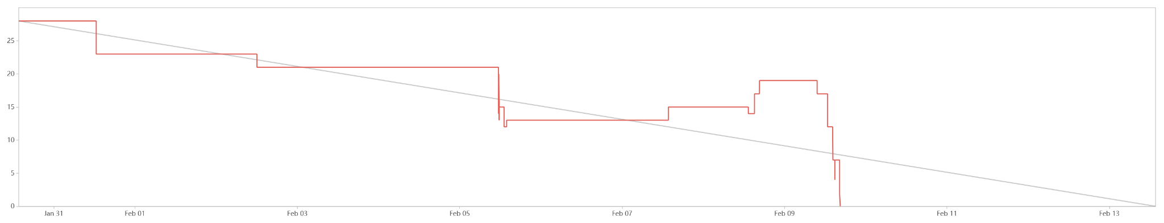
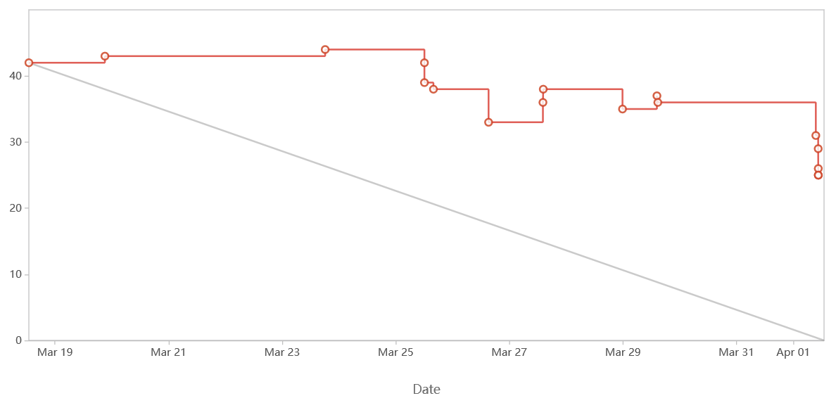
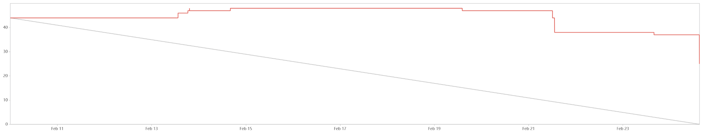
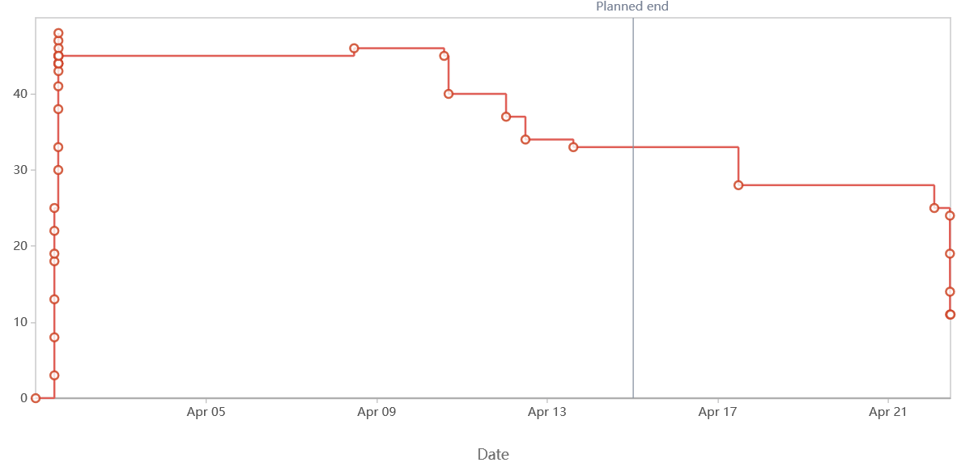
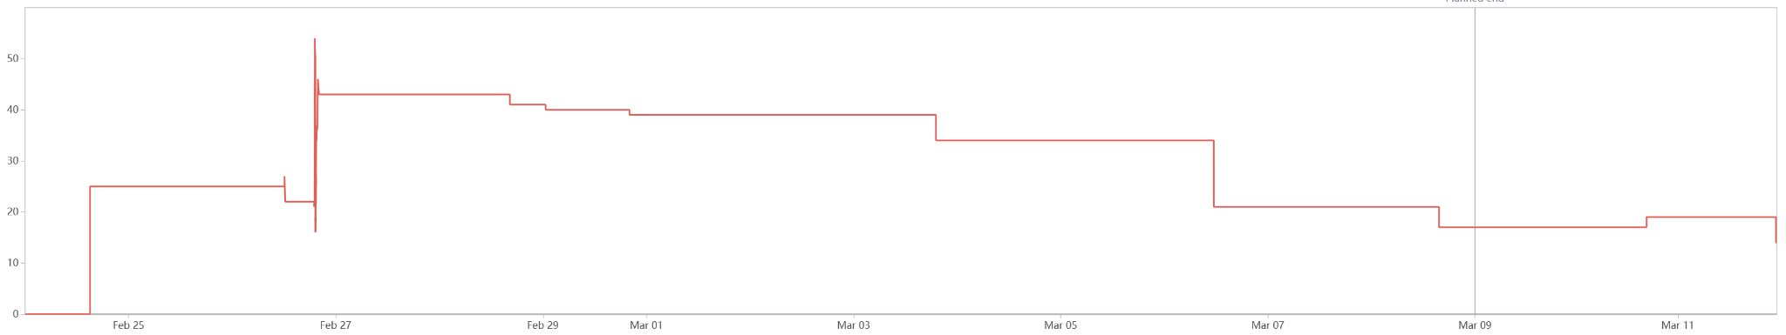
Burndown Analysis
Sprint 1
Sprint 4
Sprint 2
Sprint 5
Sprint 3
Notes:
23

Slide 5
What went well?
Testing
Jest (Mocks)
Factory for Backend API
Very few bugs merged to main
Developer Experience
Docker
Pre-Commit
Github Actions
Client Communication
Shared design proposal / Worked on Canva together
Meeting every sprint / Communicate individually for feedback

Slide 6
How have we improved?
Learned new frameworks/languages!
Much better testing practices! TDD when we can!
Got better at looking at PRs and giving feedback
Practiced communicating with external clients and iterating on their feedback!
Got better at design!

Slide 7
Why should we not get fired?
We have shown we are able to quickly learn new technologies.
We are not afraid to give constructive criticism.
We can communicate with clients effectively.
We are not married to our design choices.
We can take feedback.
Notes:
Sergio 50

